Slide 1



AI PERSONAS
Enrico Chen - s337750
Van Thanh Nguyen - s336748
Xiaoning Ma - s337332

Slide 2
Project overview
OUR GOAL
Build an AI platform that allows internal business teams to interact with AI personas representing different market segments to explore and test strategies.
Automatically organize unstructured data
Data-driven AI personas based on real market data
Explainable answers with clear references
KEY FEATURES
Reduce time and resources spent on data preprocessing
Provide trustworthy and credible responses
Help teams make more focused and informed market strategies
BENEFITS

Slide 3

VALUE PROPOSITION
For business units struggling in evaluating marketing performances, customer understanding, models and ideas testing, our platform allows interacting with data-driven AI Personas representing the different market segments

Slide 4
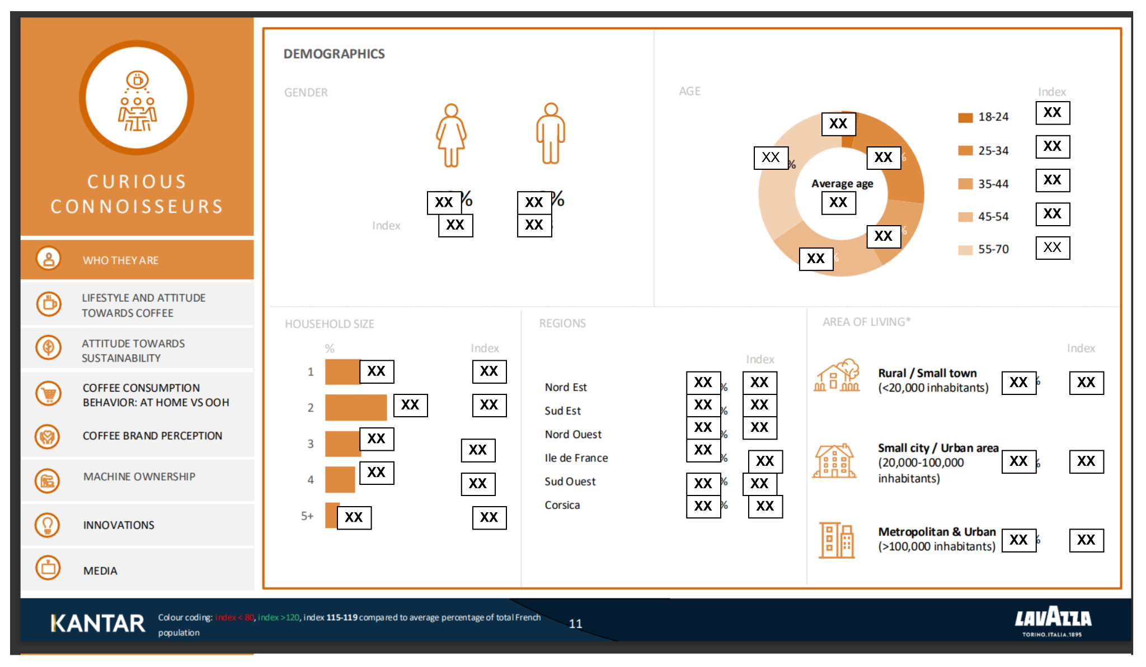
Research Questions
Extraction How can we automatically extract accurate data from complex, visually rich PDFs while preserving layout semantics?
Personality Can latent reasoning traits (style profiles & value frames) be inferred from heterogeneous, noisy raw data to build consistent AI personas?
Grounding How can hallucinations in language model outputs be reduced?
For privacy and compliance reasons, certain details are omitted from this presentation.
Notes:
During conducting the project, we meet some very important questions: - Q1: extract data from visually rich pdf
- here is an exemple page of the raw data, it typically has multiple not only the charts but also may meaning full symbol, and layout
-Q2: how can we extract the persona traits from this raw data
- Q3: how can we prevent model from hallucications from provided data

Slide 5





Research Question 1
Question:
How can we automatically extract accurate data from complex, visually rich PDFs while preserving layout semantics?
Our solution:
We treat PDFs as visual documents and extract semantic meaning using a VLLM
Alternative Solutions:
Manual annotation: high accuracy, but low scalability, high costs
OCR-based pipelines: scalable, but limited layout information
PDF rendering
VLLM
Preserves layout and spatial relationships
Fully automated, no manual rules
Directly produces schema-consistent data ready for downstream use
Notes:
During conducting the project, we meet some very important questions: - Q1: extract data from visually rich pdf
- here is an exemple page of the raw data, it typically has multiple not only the charts but also may meaning full symbol, and layout
-Q2: how can we extract the persona traits from this raw data
- Q3: how can we prevent model from hallucications from provided data

Slide 6

Research Question 2
Question:
Can we infer latent reasoning traits from heterogeneous, noisy raw data in order to build consistent AI personas?
Our solution:
We use a cooperative multi-agent system in which each agent specialises in a specific stage of reasoning and trait inference.
Alternative Solutions:
Human review and inference: high accuracy but slow, subjective, and not scalable
Single-model end-to-end inference：automated, but sensitive to noise and lacking trait consistency
Agent 1
Extract from raw data to get persona information
Agent 2
Infer latent persona reasoning traits by identifying patterns in language use, metrics, and expressed priorities
Scalable and repeatable across datasets
Reduces subjective human bias
Produces consistent persona traits at scale
Notes:
During conducting the project, we meet some very important questions: - Q1: extract data from visually rich pdf
- here is an exemple page of the raw data, it typically has multiple not only the charts but also may meaning full symbol, and layout
-Q2: how can we extract the persona traits from this raw data
- Q3: how can we prevent model from hallucications from provided data

Slide 7
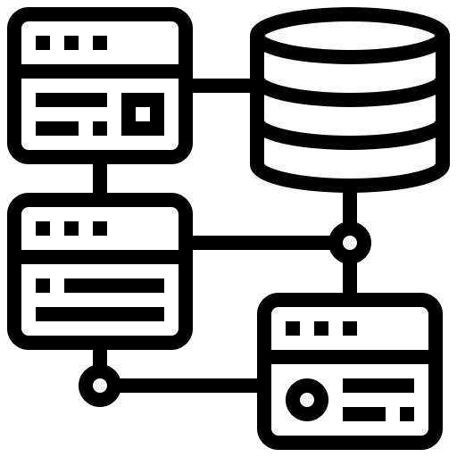
Research Question 3
Question:
How can we reduce hallucinations in language model outputs?
Our solution:
We integrate a RAG system that retrieves relevant evidence before generation and constraints model outputs to the retrieved context.
Alternative Solutions:
Prompt-based: lightweight, but unreliable and sensitive to prompt design
Pure fine-tuning: improves fluency, but does not guarantee factual grounding, computationally expensive
Improves factual accuracy
Reduces hallucinations caused by unsupported generation
Explainable responses
Low computational costs
Notes:
During conducting the project, we meet some very important questions: - Q1: extract data from visually rich pdf
- here is an exemple page of the raw data, it typically has multiple not only the charts but also may meaning full symbol, and layout
-Q2: how can we extract the persona traits from this raw data
- Q3: how can we prevent model from hallucications from provided data

Slide 8



Dataset
Source & Scale
Data Structure
Key Dimensions
Kantar France 2023
4,001 Respondents
9 consumer segments
Rich qualitative + quantitative data
Multi-modal composition
Inconsistent layouts across segments
Mixed granularity
No unified or machine-readable format
Demographics
Psychographics
Coffee attitudes
Consumption behaviours
Brand perception & sustainability attitudes

Slide 9



Functional Diagram
Memory
Query
Orchestrator
Prompt Constructor
LLM
Response
Online Process
Data Ingestion
RAG
Fact and indicator extraction
Dataset
Persona Registry
Persona traits extraction
Fact data: all data (including segments characteristics, market data)
Persona traits data: characteristics of the customer segments (like tone, style, values, preferences)
Notes:
We will see how the components of the system interact eachother to handle the query of user in this functional diagram
User sent input possibly has images and pdf -> orchestrator are an agentic planner of the system : applied some design pattern such as CoT and ReAct to plainning the strategy to answer the query, decide which actions should be done: -> call the memory to retrieve the relevant history of the chat -> parsing extracting useful information from input -> call the RAG to retrieve relevant internal fact data -> call Model Context Protocol server to using some useful tools such as websearch, call external apis … -> contexts will be aggregated by orchestrator-> entire the reasoning process will be tracked by explanation services to allow explain the reasoning and the source of used data.
All relevant context will be sent to prompt construction and be enhanced by persona traits -> stick llm model with particular persona during the generation answer and avoid hallucination

Slide 10
Functional Diagram
Memory
Query
Orchestrator
Prompt Constructor
LLM
Response
Online Process
Data Ingestion
RAG
Fact and indicator extraction
Dataset
Persona Registry
Persona traits extraction
Fact data: all data (including segments characteristics, market data)
Persona traits data: characteristics of the customer segments (like tone, style, values, preferences)
Notes:
We will see how the components of the system interact eachother to handle the query of user in this functional diagram
User sent input possibly has images and pdf -> orchestrator are an agentic planner of the system : applied some design pattern such as CoT and ReAct to plainning the strategy to answer the query, decide which actions should be done: -> call the memory to retrieve the relevant history of the chat -> parsing extracting useful information from input -> call the RAG to retrieve relevant internal fact data -> call Model Context Protocol server to using some useful tools such as websearch, call external apis … -> contexts will be aggregated by orchestrator-> entire the reasoning process will be tracked by explanation services to allow explain the reasoning and the source of used data.
All relevant context will be sent to prompt construction and be enhanced by persona traits -> stick llm model with particular persona during the generation answer and avoid hallucination

Slide 11





Method - Persona Extraction
VLLM Extraction
VLLM Reasoning
Prompt tuning
Fine-tuned AI Personas
Each page of the dataset
JSON indicators
Persona Traits
Chunker and Embedding Model
Database
Notes:
n the persona extractions pipeline, i will present like the follow of the diagram basically, from raw data -> parsing to get data of eachpage -> using vllm model to extract useful data from page -> transform it into more structure data called indicators, indicators are stagements and mectrics which related to persona of customer segmentation -> aggreage indicators of each persona and sent to llm model to resasoning generate the structure data discribe for the persona such as style, value, behavior, priorities, ... -> apply this structure data for prompt tuning to align pretrain model with a specific persona we assume that generation llm model trained on massive data which contains multiple different personas. prompt engineering applied here helps to activate the specific persona we want the model to stick with

Slide 12


Method - Fact Extraction
VLLM
Chunker
Embedding Model
Each page of the dataset
Markdown output
Chunked output
Database

Slide 13




Method - Application
Features implemented
1
Authentication
2
Customer segment selection
3
Past chat selection
4
Context customization
Back-end
(REST APIs)
Handles system operations and provides results to the frontend
Front-end
User interface for interacting with the backend, built with Streamlit
5
Persona name customization
6
Persona information
Notes:
WSGI (web server gateway interface) is synchronous, handling one request at a time, and blocking execution until processing is complete. ASGI is asynchronous, handling multiple requests concurrently without blocking other requests.

Slide 14
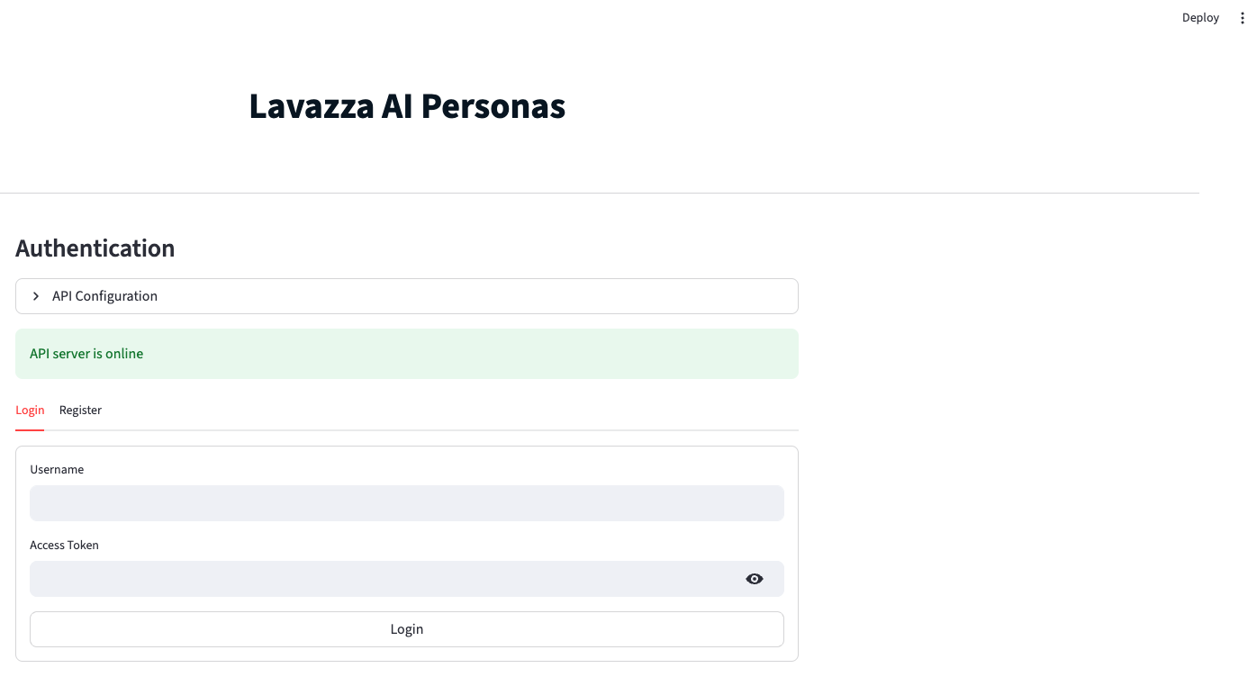
UI - Login

Slide 15
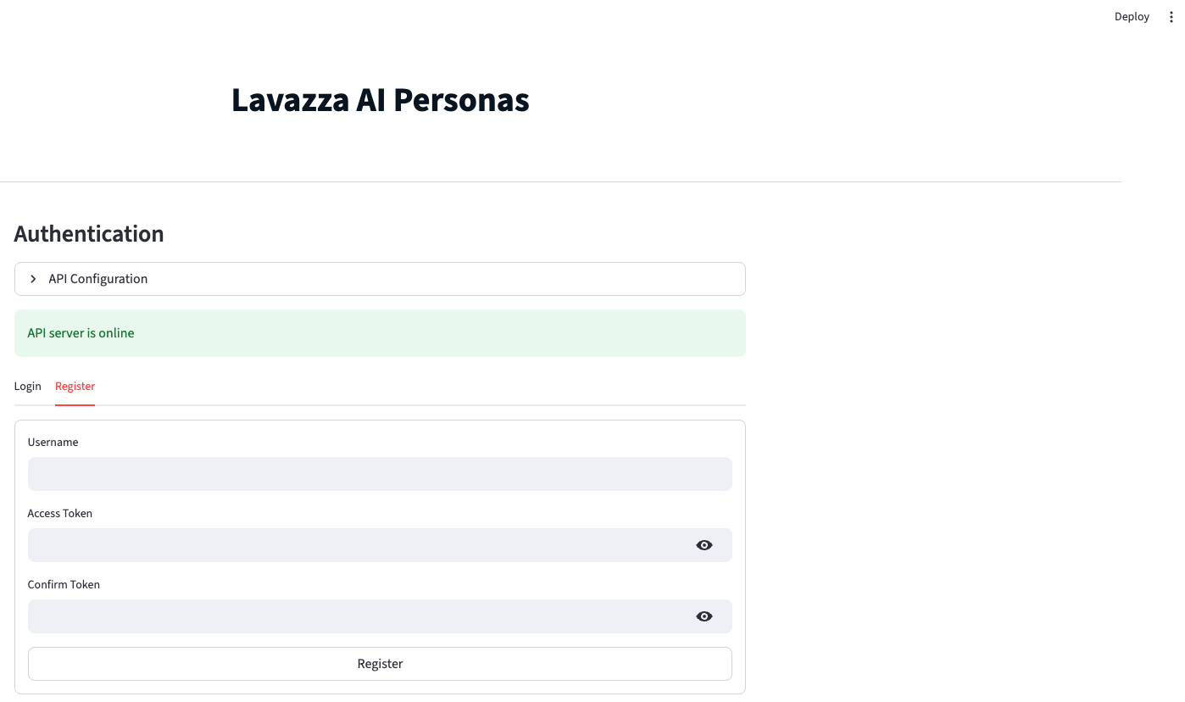
UI - Registration

Slide 16
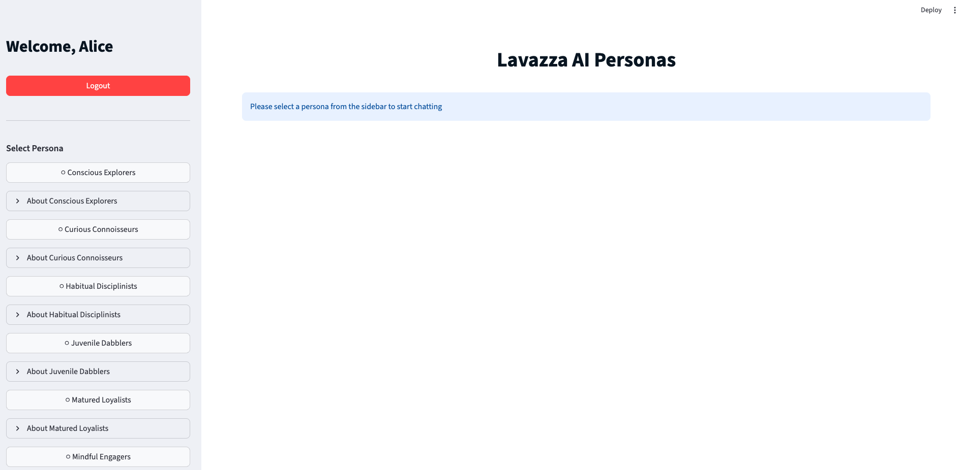
UI - Homepage

Slide 17
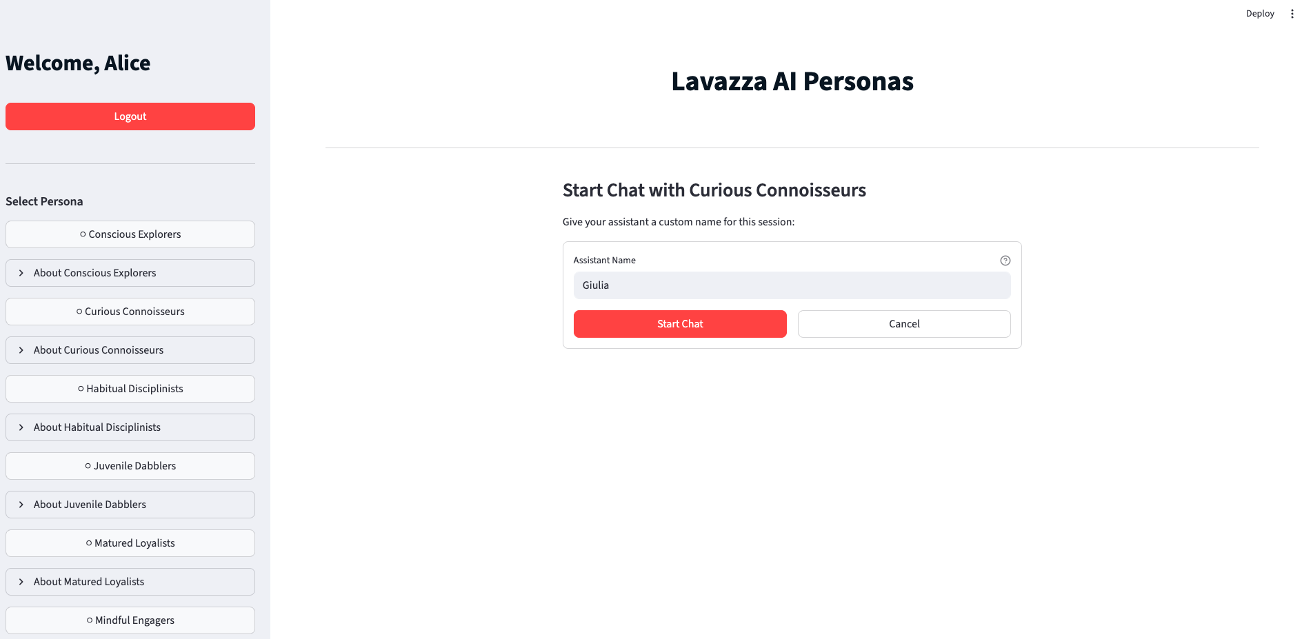
UI - Persona name customization

Slide 18
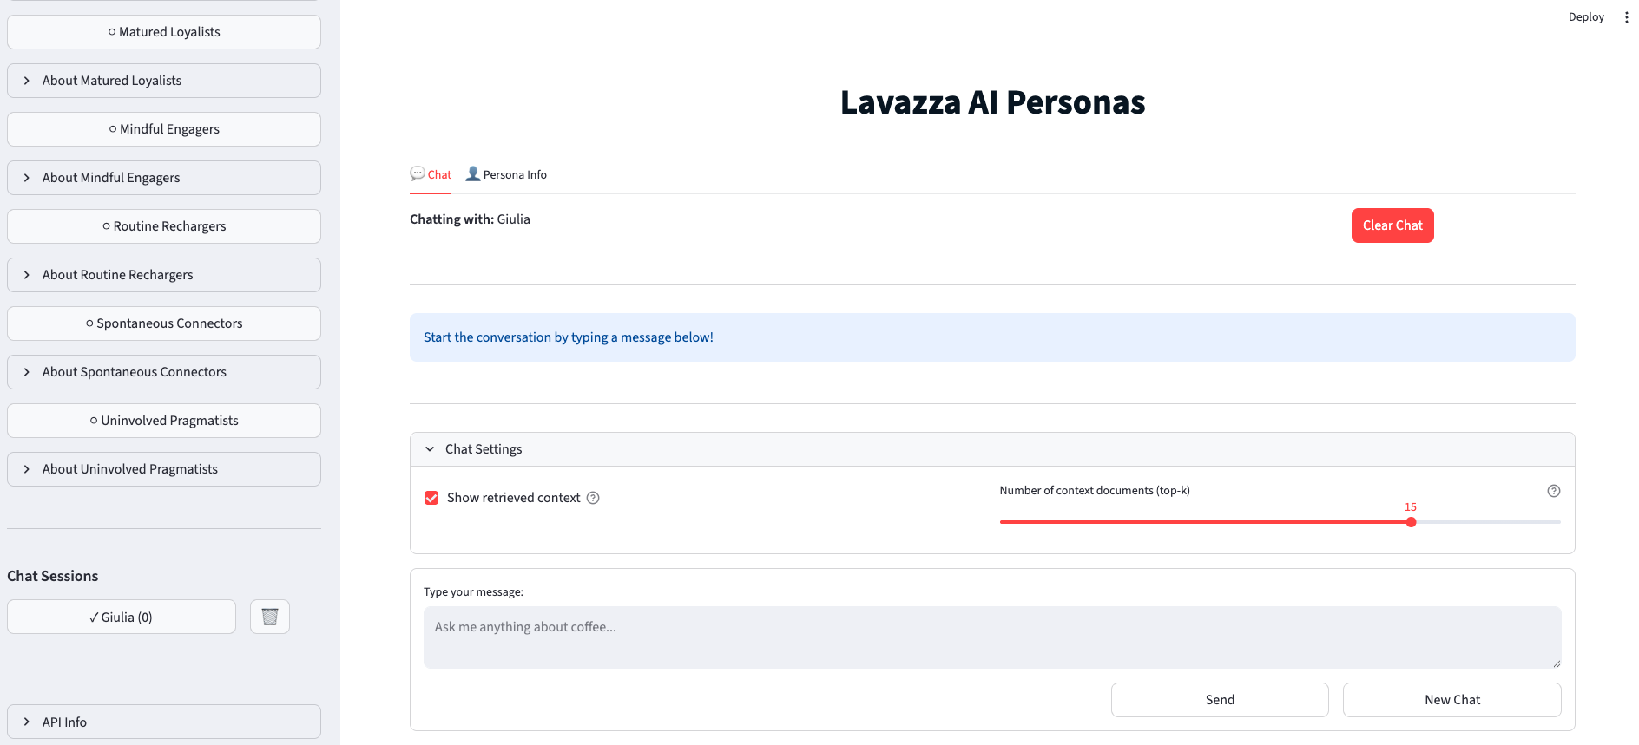
UI - Chat Management

Slide 19
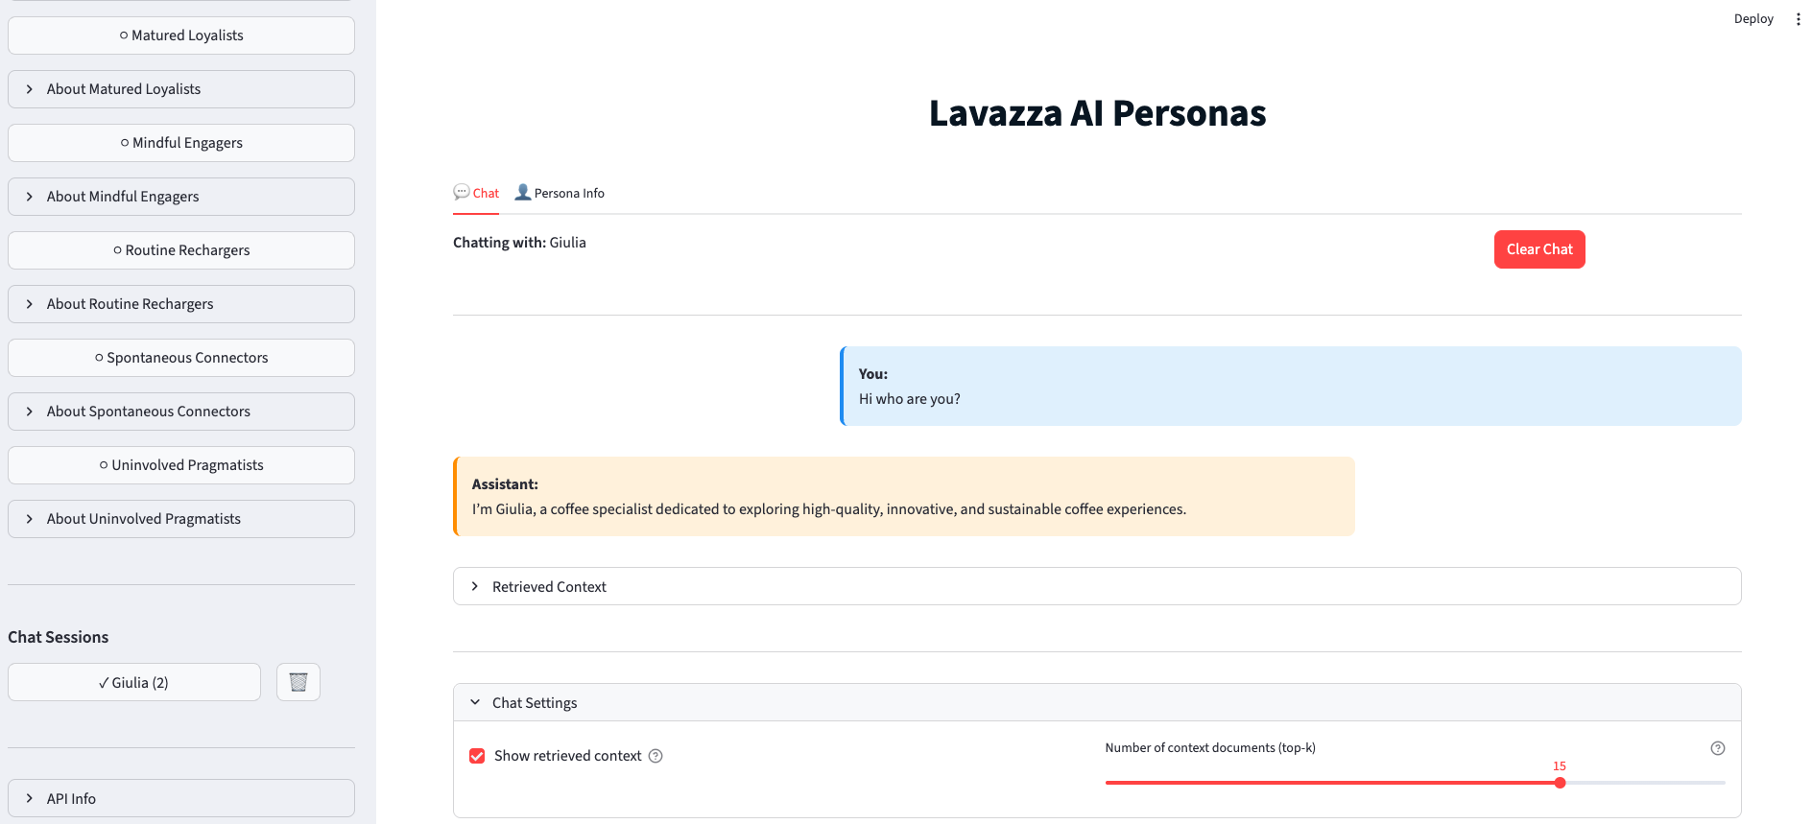
UI - Chat Interaction

Slide 20

Evaluation
Persona Extraction
Is persona information correctly extracted?
Fact Extraction
Is extracted fact data correct?
Retrieval Relevance
Is the retrieved information relevant?
Authenticity Evaluation
Do personas reflect real consumer segments?
Notes:
evaluation methodologies for four critical components of the Lavazza AI Personas system 1.Persona Extraction Pipeline - Validates extraction of persona indicators/metrics from PDF documents
2.Fact Extraction Accuracy - Ensures fact data is correctly extracted
3.Retrieval Relevance - Measures RAG system's ability to retrieve relevant context
4.Authenticity Evaluation - Confirms AI personas authentically represent consumer segments

Slide 21

Evaluation - Persona Extraction
Approach
Compare persona extraction outputs with manually annotated ground truth.
Metrics
Persona Detection Rate Are all target personas identified?
Metrics Recall Is the required information complete?
Metrics Precision Is the extracted information accurate?
*Persona Detection Rate = (Correctly Detected Personas) / (Total Ground Truth Personas)
*Metrics Recall = (Correctly Metrics) / (Total Ground Truth Metrics)
*Metrics Precision = (Correct Metrics) / (All Extracted Metrics)

Slide 22
Evaluation - Persona Extraction
Configuration
Models:
Extract indicators: mistralai/mistral-medium-3-instruct
Persona traits reasoning: mistralai/mistral-medium-3-instruct
Test dataset:
Scope: 23 pages focused on the Curious Connoisseurs segment
Source: Customer Segmentation Analysis PDF
Ground Truth: 1,051 metrics manually extracted and validated from the PDF
Result
Score
Interpretation
Persona Detection Rate
100%
All personas correctly identified (23/23)
Metrics Recall
95.30%
Very high coverage of ground-truth metrics (1002/1051)
Minimal noise in extracted metrics (1002/1035)
Metrics Precision
96.80%
Notes:
Mistral Medium 3 model has not been publicly disclosed by Mistral AI.
Total 23 pages
Ground-truth personas
23
Detected personas
23
Ground-truth metrics
1,051
System-extracted metrics
1,035
Correctly matched metrics
1,002
Missed ground-truth metrics
49
Incorrect system metrics (noise)
33

Slide 23
Evaluation - Fact Extraction
Approach
Manually verify numeric and factual data against source PDFs.
Run extraction and check exact matches.
A result is correct only if ≥80% textual overlap with the extracted markdown.
Metrics
Exact Match Accuracy what fraction of expected facts were extracted correctly?
*Exact Match Accuracy = (Exactly Matching Values) / (Total Ground Truth Values)

Slide 24
Evaluation - Fact Extraction
Configuration
Models:
PDF to Markdown Conversion: mistralai/mistral-large-3-675b-instruct-2512
Test dataset:
Scope: 23 pages focused on the Curious Connoisseurs segment
Source: Customer Segmentation Analysis PDF
Ground Truth: 467 validated metric and statement snippets manually extracted from the PDF
Result
Score
Interpretation
Exact Match Accuracy
97%
High extraction accuracy with minimal deviation from ground truth
Notes:
Mistral Medium 3 model has not been publicly disclosed by Mistral AI.
Total 23 pages
Ground-truth personas
23
Detected personas
23
Ground-truth metrics
1,051
System-extracted metrics
1,035
Correctly matched metrics
1,002
Missed ground-truth metrics
49
Incorrect system metrics (noise)
33

Slide 25
Evaluation - Retrieval Relevance
Approach
Create persona-specific test queries.
Retrieve top-K documents (K = 3, 5, 10, 20)..
Manually label relevance for retrieval documents.
Metrics
Precision@K How many of the top K results are actually correct.
Recall@K How many of the total correct results were successfully found within the top K.
*Precision@K = (Relevant docs in top-K) / K
*Recall@K = (Relevant docs in top-K) / (Total relevant docs)

Slide 26
Evaluation - Retrieval Relevance
Configuration
Models:
Embedding: sentence-transformers/all-mpnet-base-v2
RAG setup:
Chunk Size: 1,200 characters
Chunk Overlap: 50 characters
Input: 222-page split to 712 total text chunks
Test dataset:
Source: Customer Segmentation Analysis PDF
Ground Truth: 31 evaluation questions focused on the Curious Connoisseurs segment
Score
Interpretation
Top-3 results are moderately relevant
Precision@3
58.10%
Relevant remains stable in top-5
Precision@5
56.80%
Precision@10
54.20%
Slight precision drop
Precision@20
55.50%
Precision stabilizes at broader context window
Recall@3
16.70%
Limited coverage with very short context
Recall@5
24.30%
Partial retrieval of relevant context
Recall@10
45.10%
Balanced trade-off between precision and recall
Recall@20
94.10%
Near-complete retrieval of relevant
Result
Notes:
Mistral Medium 3 model has not been publicly disclosed by Mistral AI.
Total 23 pages
Ground-truth personas
23
Detected personas
23
Ground-truth metrics
1,051
System-extracted metrics
1,035
Correctly matched metrics
1,002
Missed ground-truth metrics
49
Incorrect system metrics (noise)
33

Slide 27
Evaluation - Persona Authenticity
Approach
Generate persona-based responses to predefined questions.
Have domain experts score them on authenticity, style alignment, and factual grounding, each on a 1–5 scale.
Metrics
Expert Authenticity Score Average authenticity ratings.
Style Alignment Score Average all style alignment ratings.
Factual Grounding Score Average all factual grounding ratings.

Slide 28
Evaluation - Authenticity Results
Configuration
Models:
Filter context model: mistralai/mistral-medium-3-instruct
Generation model: mistralai/mistral-small-24b-instruct
RAG Setup:
Chunk Size: 1,200 characters (~300–350 tokens)
Chunk Overlap: 50 characters (to preserve context continuity)
Input: 222-page to 712 total text chunks
Test dataset:
Source: Customer Segmentation Analysis PDF
Ground Truth: 31 evaluation questions focused on the Curious Connoisseurs segment
Result
Score
Interpretation
Expert Authenticity Score
3.90/5
Persona behavior is largely authentic.
Style is mostly consistent, with minor
persona drift.
Style Alignment Score
3.74/5
Factual Grounding Score
3.67/5
Responses are generally grounded.
Notes:
Mistral Medium 3 model has not been publicly disclosed by Mistral AI.
Total 23 pages
Ground-truth personas
23
Detected personas
23
Ground-truth metrics
1,051
System-extracted metrics
1,035
Correctly matched metrics
1,002
Missed ground-truth metrics
49
Incorrect system metrics (noise)
33

Slide 29



Manage
Enrico
Semantic extraction of fact data
Fact data indexing and organization
Frontend application development
Related presentation slides
Thanh
Persona semantic information extraction
Backend system development
Evaluation (persona & fact data extraction)
Related presentation slides
Xiaoning
AI persona common trait extraction
Evaluation dataset construction
Evaluation (retrieval & authenticity analysis)
Related presentation slides

Slide 30

Enrico Chen - s337750
Van Thanh Nguyen - s336748
Xiaoning Ma - s337332

Slide 31

Appendix

Slide 32
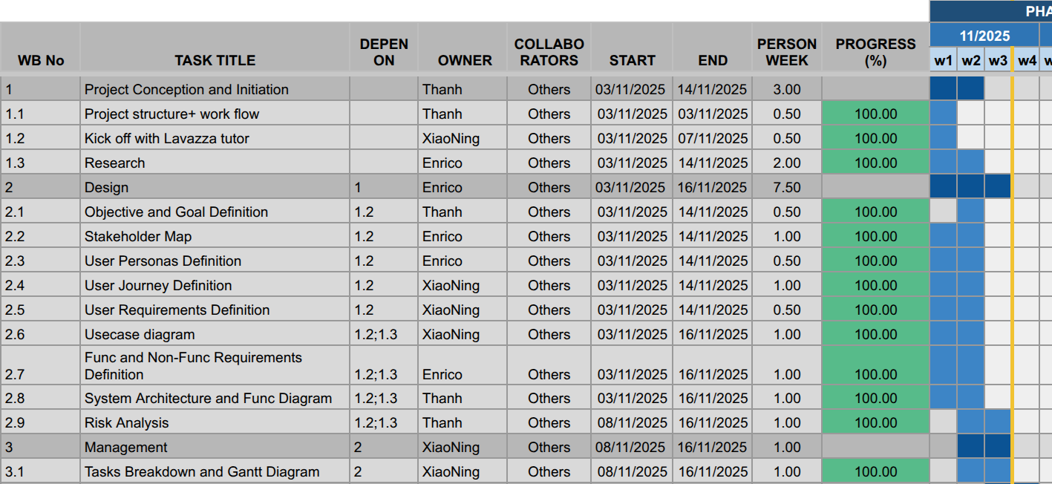

Manage - Gantt

Slide 33
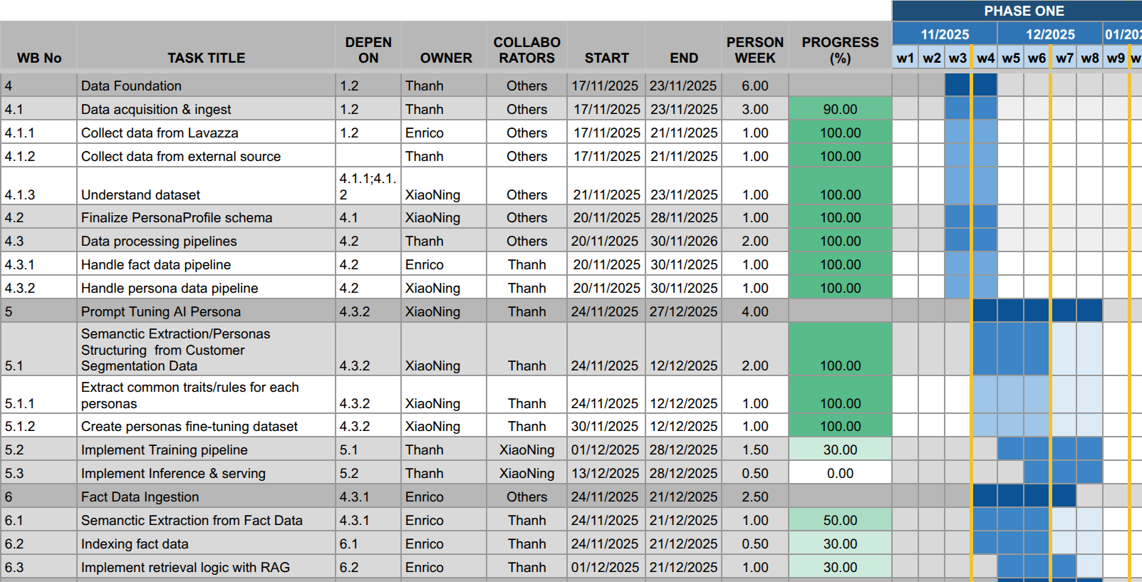
Manage - Gantt

Slide 34
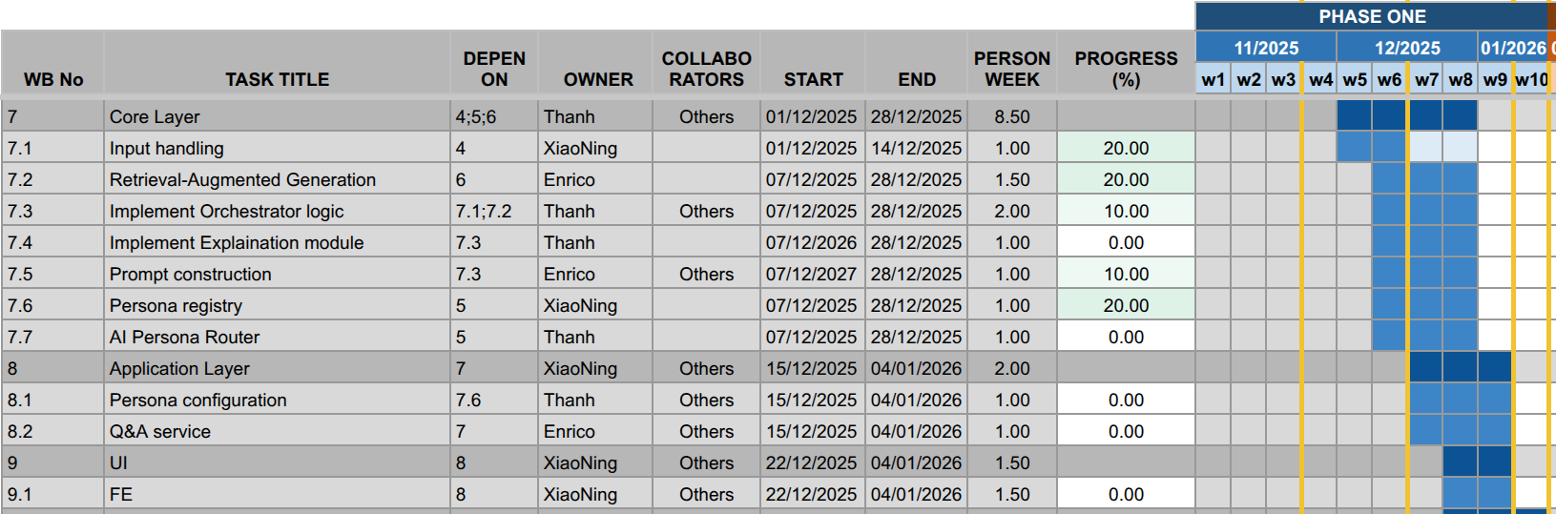
Manage - Gantt

Slide 35
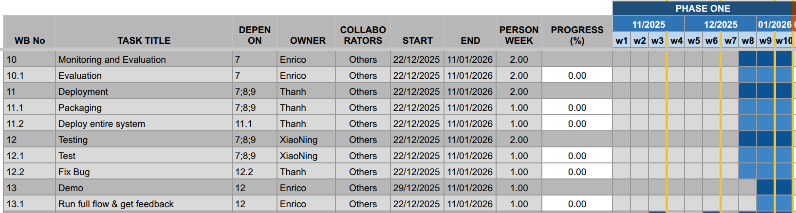
Manage - Gantt

Slide 36
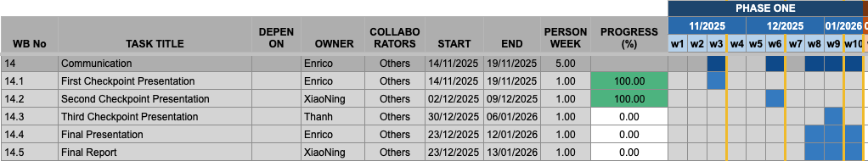
Manage - Gantt

Slide 37
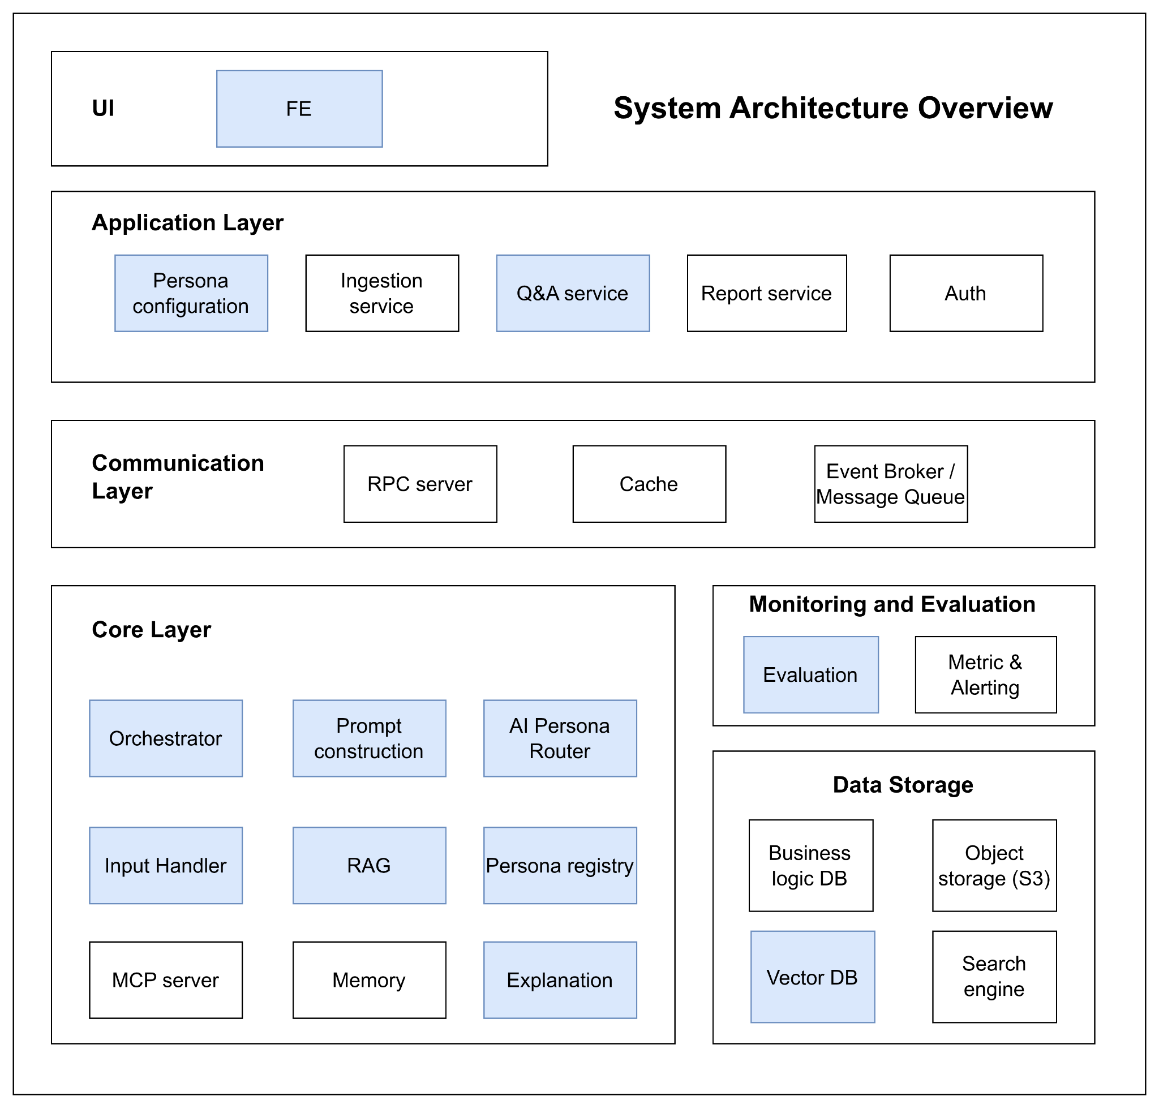
Design
1. User Interface (UI)
The user interface serves as the system’s entry point, built as a Frontend (FE) application. It enables users to interact seamlessly with the platform, submit queries, upload data, and view results or reports.
2. Application Layer
This layer contains the core application logic and manages all user-driven workflows.
Key components include:
Persona Configuration: Enables users to select or customize AI personas dynamically.
Ingestion Service: Handles ingestion of raw data such as PDFs or images and stores them in S3.
Report Service: Generates structured, formatted reports from processed and analyzed data.
Q&A Service: Manages interactive question-and-answer exchanges with the AI.
Auth Service: Provides authentication and authorization for users, ensuring secure access and operations.
3. Communication Layer
This layer facilitates efficient communication and coordination among microservices.
RPC Server: Enables direct service-to-service communication via Remote Procedure Calls.
Cache: A high-speed memory layer that stores frequently accessed data to optimize performance.
Event Broker / Message Queue (RabbitMQ or Kafka): Handles asynchronous communication and event-driven processing across services, ensuring reliability, scalability, and robust monitoring.

Slide 38
Design
4. Core Layer
The intelligence engine of the system—handles AI persona logic, LLM orchestration, and data-driven grounding.
Orchestrator: The central coordinator of the Core Layer. When a request arrives, the Orchestrator manages the entire generation process, directing which services to call.
Input Handler: Preprocesses and normalizes user inputs, including text extraction from PDFs and preparation of image data for AI analysis.
Prompt Construction: Dynamically builds structured prompts by combining user input, persona rules, and retrieved data.
AI Personas: Represents the fine-tuned Large Language Models (LLMs) tailored to embody distinct customer segment personalities.
RAG (Retrieval-Augmented Generation): Provides factual grounding by retrieving relevant information from the Vector DB, ensuring responses remain accurate.
Persona Registry: Stores the static attributes and behavioral definitions of each persona, guiding prompt construction and response tone.
Explanation: This module allows for an in-depth explanation of the thought process behind the reasoning model and the data used in the thinking process.
MCP Server (Model Context Protocol Server): Enriches LLM interactions with real-time contextual or external domain data.
Memory: It stores the recent history of the user's chat, allowing the persona to remember what was said earlier in the conversation and provide context-aware answers.

Slide 39
Design
5. Monitoring and Evaluation
A centralized observability layer that tracks performance, quality, and reliability across all services.
Evaluation Tools: Measure the accuracy and quality of AI responses and data processing outcomes.
Metrics & Alerting: Monitor key indicators such as latency, error rates, resource utilization, and token usage, triggering alerts for anomalies or system degradation.
6. Data Storage Layer
The persistence foundation of the system, designed for scalability, durability, and speed.
Business Logic Database: Stores structured data such as user profiles, authentication records, saved reports, and persona definitions.
Object Storage (S3): Manages large, unstructured data files (e.g., raw PDFs, images, and uploaded datasets).
Vector Database: Stores embeddings for persona-related documents, historical interactions, and reference materials — powering RAG retrieval and factual grounding.

Slide 40
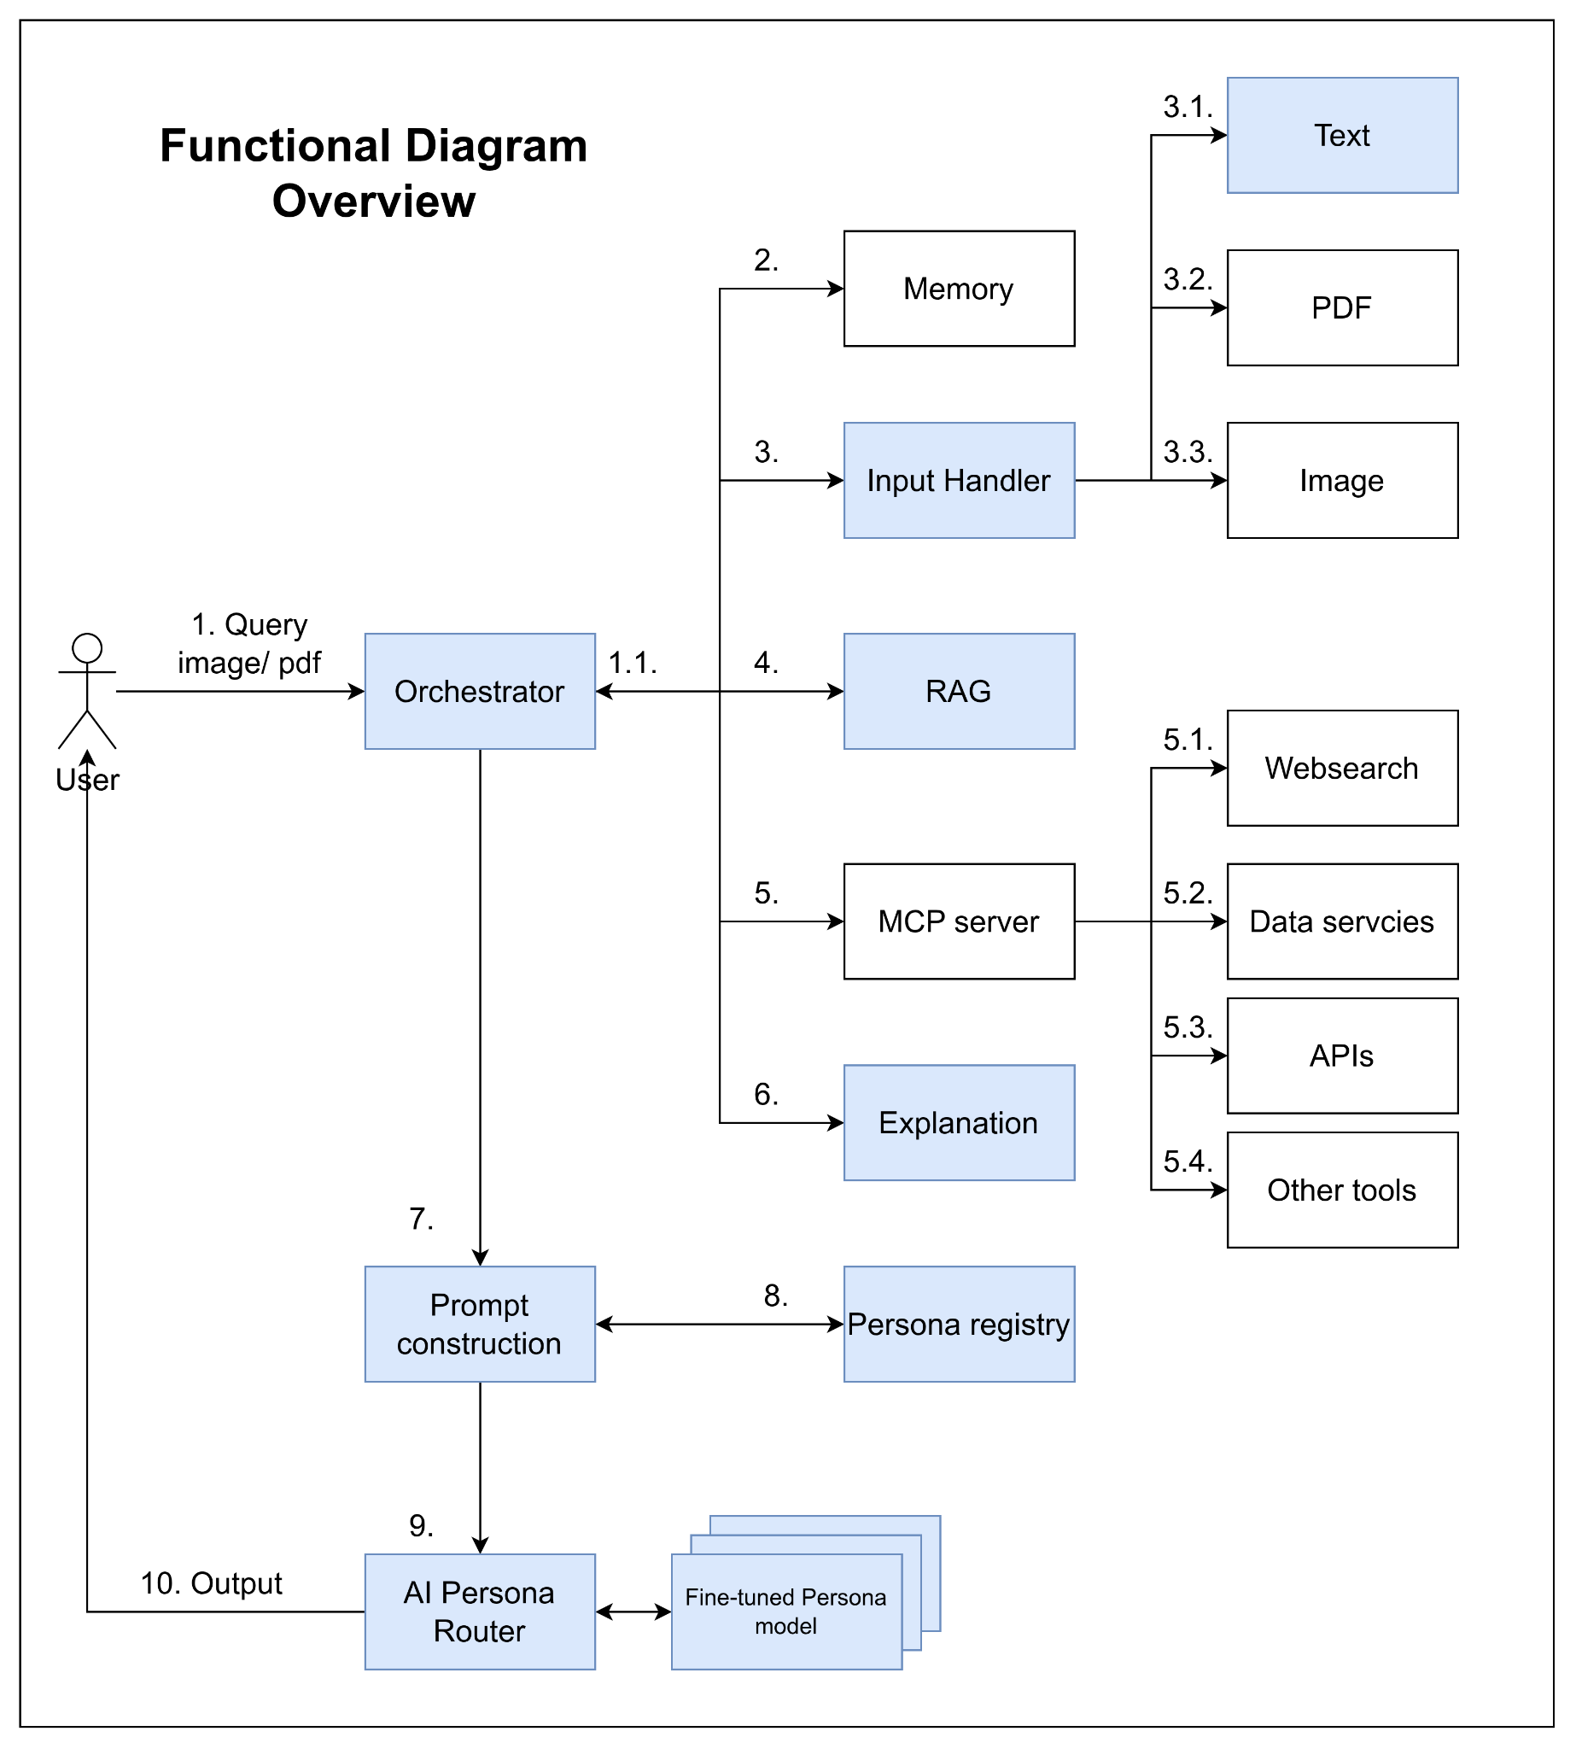
Design
1. User Query Submission: User sends a query with optional attached files (image, PDF, etc.) to the Orchestrator.
1.1 Orchestrator Analysis: The Orchestrator analyzes the query and attachments to decide which services should be used.
2. Memory Integration :Extract useful information from chat history.
3. Input Preprocessing: Inputs are preprocessed before passing to the model.
3.1 Text Input: Normalize text to make it easier to handle in later steps.
3.2 PDF Input: Parse, process, and extract meaningful information from PDF files.
3.3 Image Input: Process images and extract valuable information.
4. Context Retrieval (RAG System): Use the query and relevant input information to retrieve context (e.g., market data) via a RAG system.
5. Tool Selection & MCP Server Requests
Decide which tools should be used to enrich the context.
Send requests to the MCP server to gather corresponding context.
5.1 Web Search: Extract updated information from the internet (trends, real-time data, missing internal data, etc.).
5.2 Database Query: Retrieve useful data from internal or external databases.
5.3 External APIs: Call APIs to obtain additional information.
5.4 Other Tools: Use calculators, simulators, weather data extractors, or other utilities to enrich context.
6. Explanation: The explanation module will explain in detail the thought process of the reasoning model and the data used for the thinking process.
7. Prompt Construction: The Orchestrator aggregates useful context and passes it to Prompt Construction.
8. Persona Selection :Apply the selected Persona profile, including: Demographics, Behavior Data, Transactional Data, …
9. Persona Model Routing
Route to a fine-tuned Persona model.
Pass the enriched prompt and context.
10. Model Response: Generate a response with: Specific personality,Tone, Linguistic style of the Persona

Slide 41
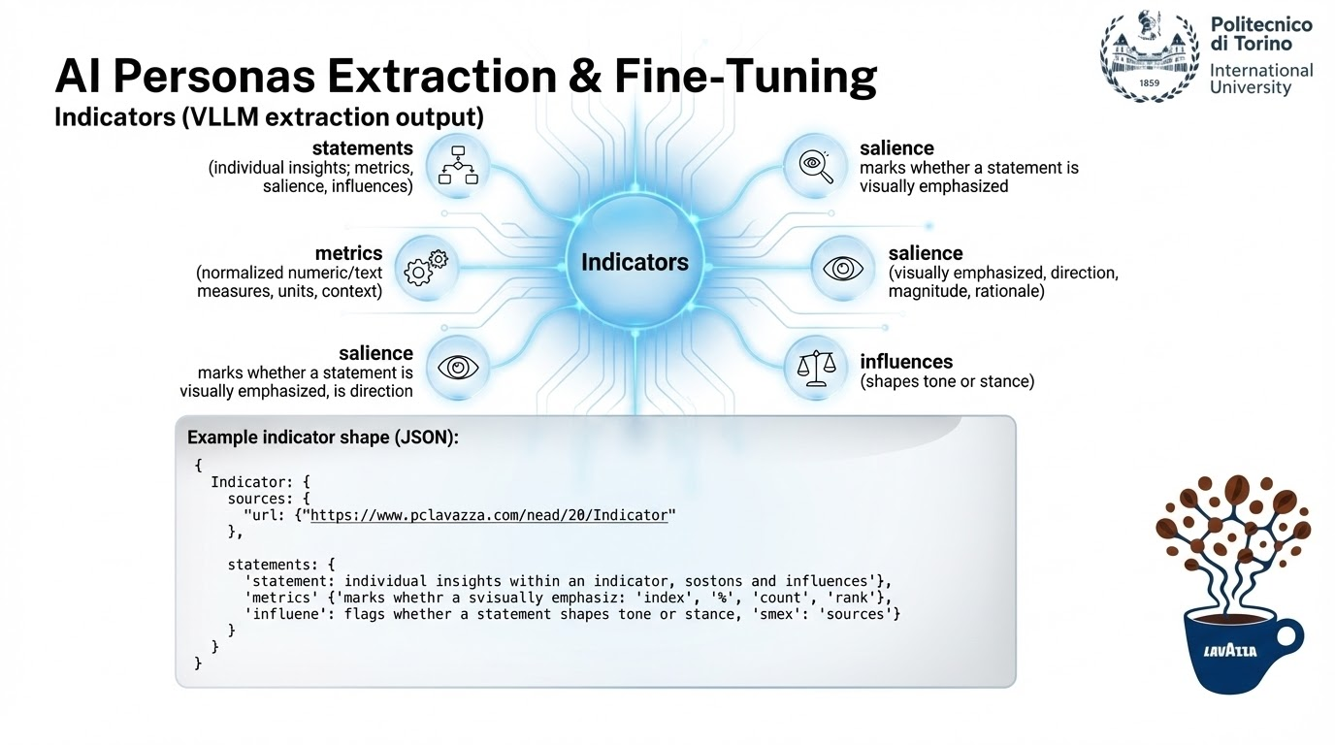

Slide 42
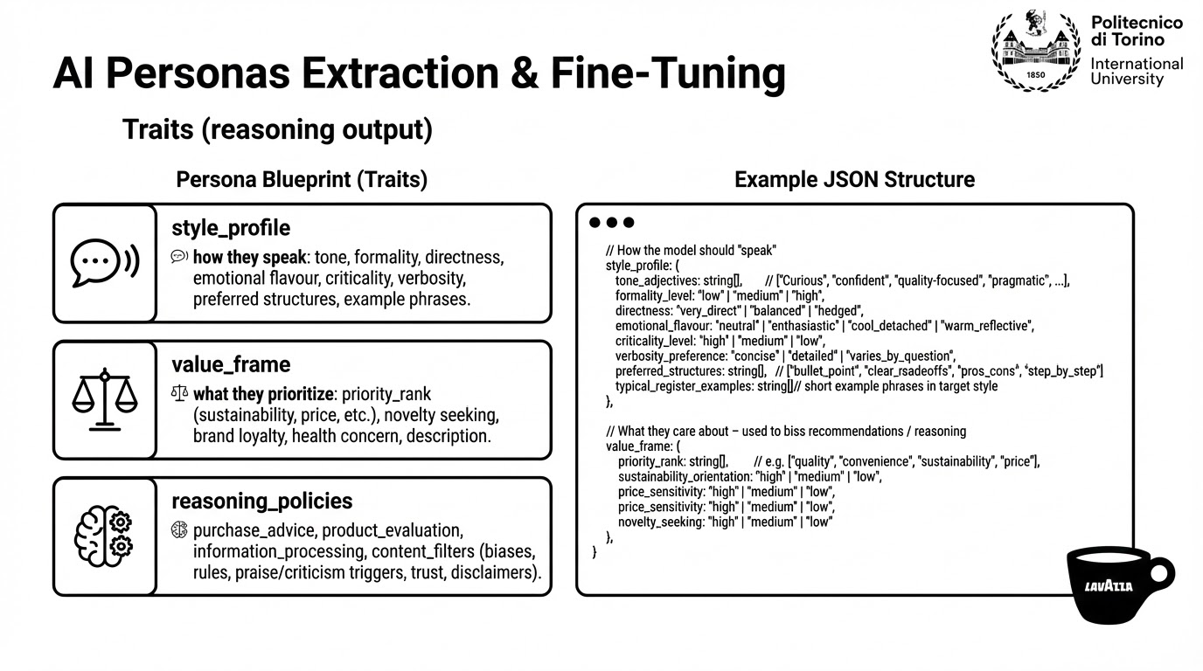

Slide 43
Design - Risks Analysis
Technical Risks
Hallucinations and inaccurate responses: mitigate with RAG system
Insufficient critical thinking: mitigate with RAG and prompt engineering
Opacity: mitigate with RAG
Inconsistent or generic personality: mitigate by fine-tuning (in case of limited resource use PEFT, smaller models, RAG with few-shot prompting)
Performance evaluation difficulty

Slide 44
Design - Risks Analysis
Governance and Security Risks
Privacy and compliance with AI Act and GDPR
Proprietary data protection
System integration difficulty with existing systems and infrastructure
Notes:
Privacy and Complience: complice AI acts and GDPR.
Proprietary Data Protection: Safeguard Lavazza’s business data, maintaining strict confidentiality and preventing unauthorized access.
System Integration: Ensure smooth and secure alignment of AI solutions with Lavazza’s existing company systems and infrastructure.

Slide 45
Design - Risks Analysis
Data and Other Risks
Data integration difficulty
Data quality and bias
Over relying on AI Personas
Notes:
2. Data Risks
Data Integration Challenge: Heterogeneous (e.g., PDFs, tabular data, …)
Quality and Bias Issues: Data may be qualitative, incomplete, or imbalanced across segments, leading to biased persona representations and limited generalizability.

